Slide 1
PRESENTATION
FUNCTION OF KEYBOARD AND MOUSE

Slide 2
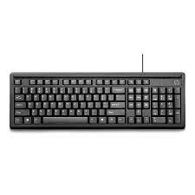
KEYBOARD
Keyboard is a input device that allows you to enter letters, numbers and symbols into your computer.
Two type of keyboard
Wired and wireless

Slide 3
TYPE OF KEYS
FUNCTION KEYS: F1 TO F12
NAVIGATION KEYS :UP,DOWN,LEFT ,RIGHT
NUMERIC KEYS : 0 TO 9
TYPING KEYS : A TO Z
CONTROL KEYS :
OTHER KEYS : ( SHIFT, CAPS LOCK,SPACE)

Slide 4
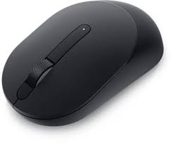
MOUSE
The mouse is a small moveable device that lets you control a range of you control a range of things on a computer

Slide 5
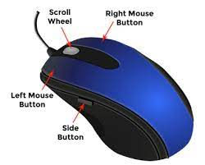
FUNCTION OF MOUSE
Open Program
select text and file
Drag and Drop
Hover and scroll

Slide 6
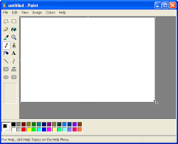
APPLICATION OF MS PAINT/NOTEPAD
Microsoft Paint is a simple raster graphics editor that has been included with all versions of Microsoft Windows

Slide 7
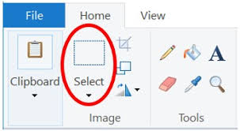
FUNCTION OF MS PAINT
DRAW COLOUR
EDIT PICTURES
ADD TEXT
ADD LINE AND SHAPE
ERASER

Slide 8
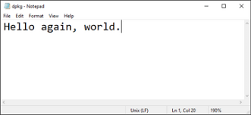
NOTEPAD
FIRST NOTEPAD RELEASED IN 1983
Notepad is a simple text editor for Microsoft Windows and a basic text-editing program which enables computer users to create documents.

Slide 9
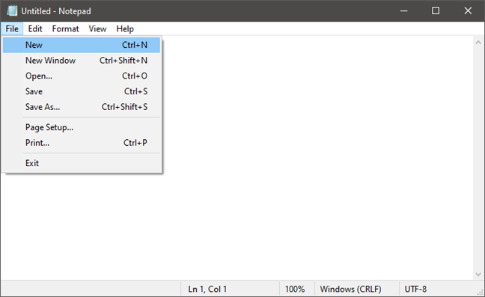
FUNCTION OF NOTEPAD
CRAETE A LOG TYPE FILE
ADD DATE AND TIME

Slide 10
DIFFERENT TEXT FORMATS
TEXT BASED ALSO REFERS TO DOCUMENTS TO CONTAIN ONLY TEXT
TEXT BASED DOCUMENTS ARE REDABLE IN ANY TEXT EDITOR AND MOST WORD PROCESSOR.

Slide 11
TYPE OF TEXT FORMATS
.DOC :MICROSOFT WORD FILE
.ODT : OPEN OFFICE WRITER DOCUMENT FILE
.PDF :ADOBE PORTABLE DOCUMENT FORMAT FILE
.RTF : RICH TEXT FORMATS (WORDPAD FILE )
.TXT : PLAINT TEXT FILES
.WPD : WORD PERFECT DOCUMENT

Slide 12


